Slide 1
Experimental design
F20PA - Research Methods and Requirements Engineering
Adapted from slides provided by Dr. Ryad Soobhany and Dr. Theodoros Georgiou

Slide 2
In this lecture…
What is an experiment?
Subjective and Objective data
Quantitative and Qualitative data
Experimental Design
Working with users
Basic statistical analysis

Slide 3
What is an experiment?
It is a scientific study methodology, that is designed specifically to allow researchers to draw conclusions about causality based on data analysis and evaluation.
An experiment has certain key components
  Hypothesis(es)
    Statement to be proven
  Independent variable(s)
    What you manipulate or change
    This is the part of your experiment you have control over.
  Dependent variable(s)
    What you measure – data you are collecting

Slide 4
Experiments...things to think about
What are you evaluating?
Narrow it down
  Figure out what you are comparing
Who are your participants going to be?
  Students?
  Other people?
  Or a mix?
Consider the procedure.
  What order should they do things in?
  How long it will take etc.

Slide 5
Data
Whether you are comparing two systems
OR
Doing a usability test for one system
  ...you need to collect data
Why?
Because it gives you evidence for your claims
Types of data
  Subjective vs Objective
  Quantitative vs Qualitative

Slide 6
Subjective Data
Subjective data is data that is collected or obtained via personal interactions,
  i.e., talking, sharing, explaining, etc.
It is collected to make an assumption about what the fact might be, what event might have occurred, what calculations may have to be done, etc.
This data varies from one person to another, with every situation, every minute.
It cannot be declared as the truth, as it evolves from so many sources with different inputs.

Slide 7
Objective Data
Objective Data is the physical data we can observe using our senses.
Objective findings come in either a measurement or a direct observation.
Objective data cannot be argued, as it is measured and observed through tests, and experiments
Objective data is often easier for many to discern, as there is no grey area.

Slide 8
Subjective vs Objective
Through subjective data, an idea/assumption can be formed.
This can then be verified via gathering objective data.

Slide 9
Quantitative and Qualitative Data
Quantitative data is data that is in the form of numbers
  Or that can easily be translated into numbers.
  It can be discrete or continuous
    Age, weight, height
    The number of projects the department handles
    How many minutes/seconds it takes to complete a task
Qualitative data is not expressed in numbers or numerical forms
  Descriptions, quotes from interviews, images, etc.

Slide 10
Quantitative vs Qualitative Data Analysis
Quantitative data analysis uses numerical methods to ascertain magnitudes, amount, or size of something.
  Average person is 170 cm, weighs 56.5kg, and is 45years old
Qualitative data analysis focuses on the nature of something and can be represented by themes, patterns, and stories.
  Average person is tall, thin, and middle aged.

Slide 11
Experimental Flowchart
RESEARCH DATA
words
numbers
QUALITATIVE
DATA
QUANTITATIVE
DATA
what the user’s thinking
what the user’s thinking
measured by the researcher
SUBJECTIVE
SUBJECTIVE
OBJECTIVE
Open questions
Questionnaires, Likert scales, surveys
Metrics, e.g. Time, number of clicks etc.

Slide 12
Experimental Design
  Determine the goal(s)of the user study and the hypothesis being tested
  Design the experiment(s)
  Run the study
  Analyse measured data and questionnaires using statistical tests
  Summarise and present the result

Slide 13
Goals of the study
  Find out what you want to evaluate/test
  Formulate specific, testable hypothesis
Notes:
?

Slide 14
Hypothesis
A statement of fact that you are going to try to prove/disprove
An educated guess as to why something happens

Slide 15
Hypothesis: Examples
Most of the time they are written like this:
If ______ [I do this] ___ then ___ [this will happen]
E.g.,
  If I change the robot voice from male to female, then this makes the system perceived as more friendly
  If users use voice instead of text input, then this will be more efficient for texting messages

Slide 16


Hypothesis Properties: Testable
Young children can remember 1 syllable words
Our Universe is surrounded by another universe with which we have no contact

Slide 17
Hypothesis Properties: Falsifiable
In most cases, a falsifiable statement just needs one observation to disprove it
A statement that is not falsifiable usually needs some sort of exhaustive investigation
There is cheese on the Moon
The Moon is made entirely of cheese

Slide 18
Hypothesis Properties:
Scientific and Measurable
Computers are better than humans
Some computers are better than humans at playing chess

Slide 19
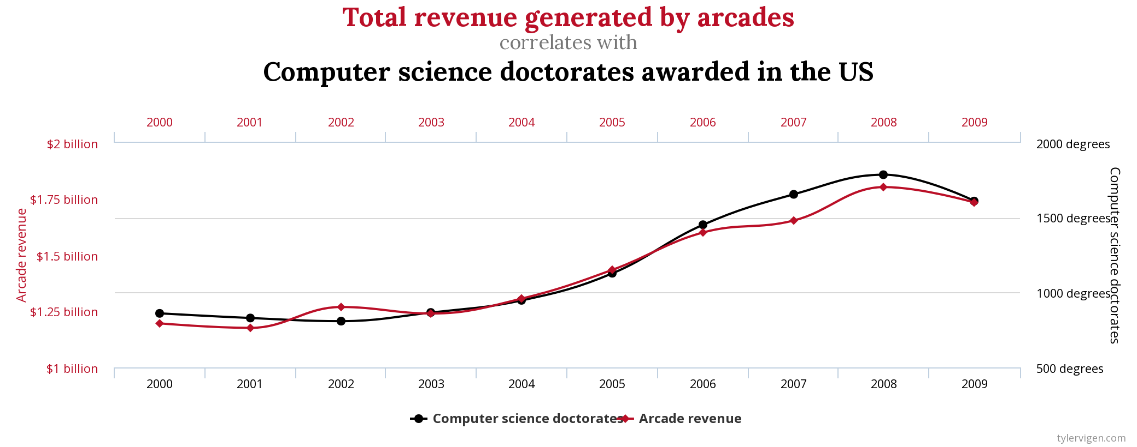
Principles of experimental design
1. Replication
* Careful measurements allow you to replicate your experiments.
2. Importance
* An experiment can be replicated and controlled but not worth it if it’s not important.
3. Control / Validity
* Some variables correlate
but don’t necessarily cause effects.

Slide 20
Designing Experiments: Recipe
Create a controlled environment
Create scenarios and tasks
Decide about measurements of metrics
Prepare questionnaires or ways to gather data
Recruit participants (5 - 1000000000)

Slide 21
Ways to work with users
Focus Groups
Interviews
Surveys
  Standardised questionnaires
  — e.g., SUS
Prototyping
User Experience (UX) testing
Expert Consultation
Crowdsourcing

Slide 22
How many users?
Formative evaluation (User Centred Design) – finding out what users think before software is finished.
  Exploratory – require depth not loads of users
Summative evaluation – Hypothesis testing on final product (e.g., system A vs system B)
  Often requires lots of people for statistically significant results

Slide 23
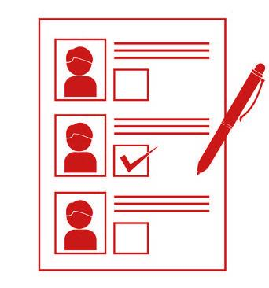
Formulating Questions for Surveys

Slide 24
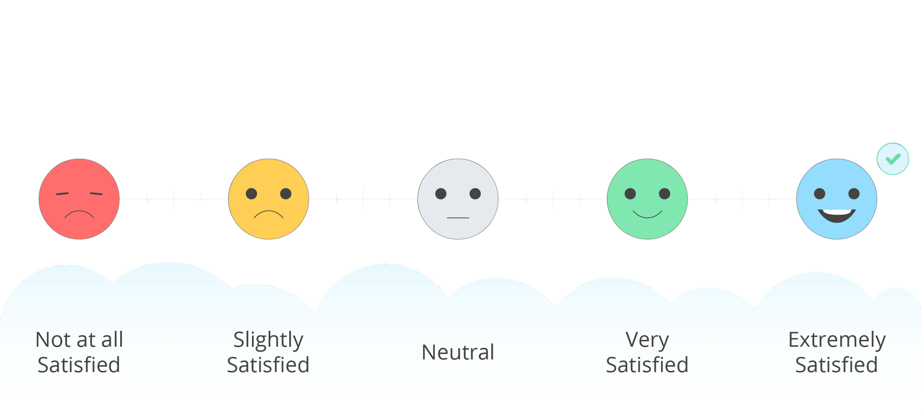
Question types
Binary questions – a question with only two possible answers (e.g. Yes/No)
  Avoid in general because it forces the interviewee to pick one even if it doesn’t represent their opinion
Closed questions – used for specific, factual information or clarification questions
  e.g. “What type of phone do you use? Pick one from the pull down list.”
  e.g., “How engaging was the dialogue system’s response? Rate from 1 to 5.” [Likert Scale]

Slide 25
Question types
Open-ended questions – used to invite participant to describe their experience
  e.g., “describe what you see on this screen”
  Useful for getting information from user without biasing their response

Slide 26
Use Standardised Questionnaires
Standardised questions are tried and tested.
They have
  good consistency across questions (i.e., they are rated pretty much along the same scale), and
  good validity (i.e., they measure what they are supposed to)
Examples
  QUIS (Questionnaire for User Interface Satisfaction)
  SUMI (Software Usability Measurement Inventory)
    both require license
  PSSUQ (Post-Study System Usability Questionnaire)
  SUS (System Usability Scale)
    free, but cite source

Slide 27
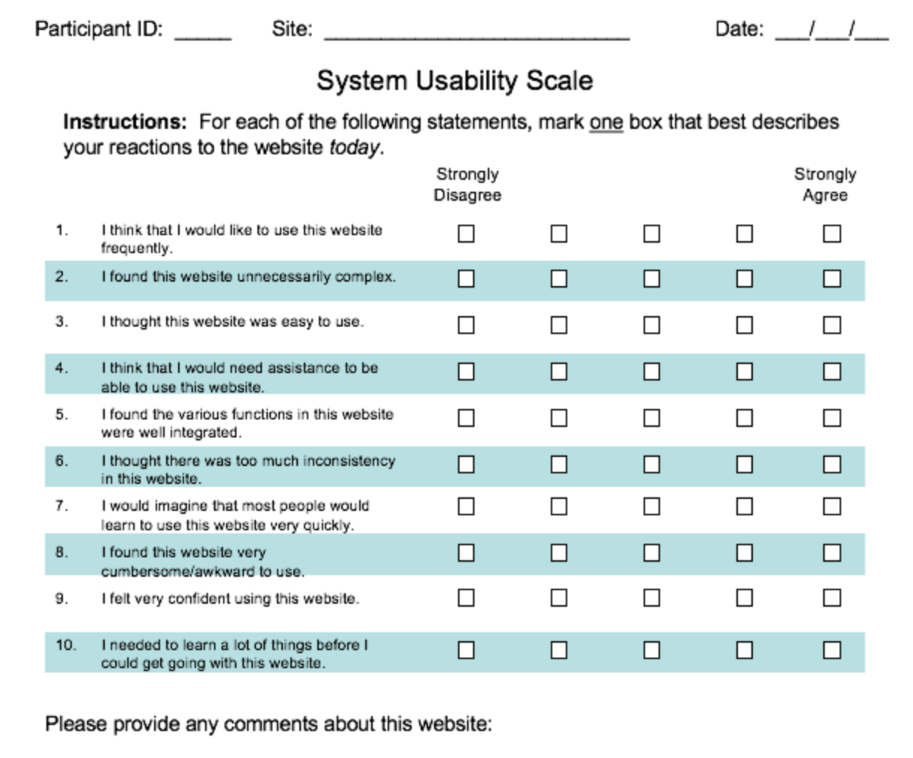

Slide 28
How do we use the collected data?
(Basic) Statistical Analysis
A way to summarize, organize, and interpret data
Helps turning raw data into meaningful information
Two main types:
  Descriptive statistics → describe data (averages, spread, patterns)
  Inferential statistics → make predictions or generalizations about a population from a sample

Slide 29
Descriptive statistics
Measures of center
  Mean, median, mode
Measures of variability
  Range, variance, standard deviation
  Data visualization
    Tables, histograms, bar charts, scatter plots

Slide 30
Inferential statistics
Hypothesis testing
  Method to check if there is enough evidence in a sample to support
  a claim about the population
Confidence intervals
  A range of values, calculated from the sample, that is likely to
  contain the true population parameter
Correlation
  Measures the strength and direction of a relationship between two variables
  Regression
    A method that models the relationship between a dependent variable
    and one (or more) independent variables.

